Slide 1

Module II – DBMS Architecture and Implementation
Reminder
1 | Introduction to Databases (F18): Lecture 8: Disks, I/O, Indexes

Slide 2
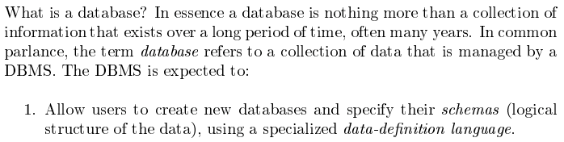
Database Management System Reminder
Covered for the relational model.
Database Systems: The Complete Book (2nd Edition) by Hector Garcia-Molina (Author), Jeffrey D. Ullman (Author), Jennifer Widom (Author)
2 | Introduction to Databases (F18): Lecture 8: Disks, I/O, Indexes © Donald F. Ferguson, 2018

Slide 3
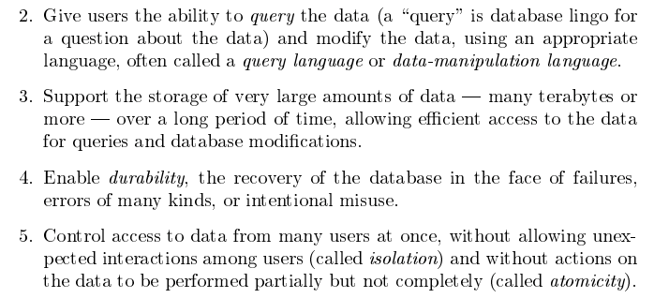
Database Management System Reminder
Focus for next part of course.
Database Systems: The Complete Book (2nd Edition) by Hector Garcia-Molina (Author), Jeffrey D. Ullman (Author), Jennifer Widom (Author)
3 | Introduction to Databases (F18): Lecture 8: Disks, I/O, Indexes © Donald F. Ferguson, 2018

Slide 4
Purpose of Database Systems
In the early days, database applications were built directly on top of file systems, which leads to:
Data redundancy and inconsistency: data is stored in multiple file formats resulting induplication of information in different files
Difficulty in accessing data
Need to write a new program to carry out each new task
Data isolation
Multiple files and formats
Integrity problems
Integrity constraints (e.g., account balance > 0) become “buried” in program code rather than being stated explicitly
Hard to add new constraints or change existing ones
Notes:
4

Slide 5
Purpose of Database Systems (Cont.)
Atomicity of updates
Failures may leave database in an inconsistent state with partial updates carried out
Example: Transfer of funds from one account to another should either complete or not happen at all
Concurrent access by multiple users
Concurrent access needed for performance
Uncontrolled concurrent accesses can lead to inconsistencies
Ex: Two people reading a balance (say 100) and updating it by withdrawing money (say 50 each) at the same time
Security problems
Hard to provide user access to some, but not all, data
Database systems offer solutions to all the above problems
Notes:
5

Slide 6
Database Engine
A database system is partitioned into modules that deal with each of the responsibilities of the overall system.
The functional components of a database system can be divided into
The storage manager,
The query processor component,
The transaction management component.
Notes:
6

Slide 7
Storage Manager
A program module that provides the interface between the low-level data stored in the database and the application programs and queries submitted to the system.
The storage manager is responsible to the following tasks:
Interaction with the OS file manager
Efficient storing, retrieving and updating of data
The storage manager components include:
Authorization and integrity manager
Transaction manager
File manager
Buffer manager
Notes:
7

Slide 8
Storage Manager (Cont.)
The storage manager implements several data structures as part of the physical system implementation:
Data files -- store the database itself
Data dictionary -- stores metadata about the structure of the database, in particular the schema of the database.
Indices -- can provide fast access to data items. A database index provides pointers to those data items that hold a particular value.
Notes:
8

Slide 9
Query Processor
The query processor components include:
DDL interpreter -- interprets DDL statements and records the definitions in the data dictionary.
DML compiler -- translates DML statements in a query language into an evaluation plan consisting of low-level instructions that the query evaluation engine understands.
The DML compiler performs query optimization; that is, it picks the lowest cost evaluation plan from among the various alternatives.
Query evaluation engine -- executes low-level instructions generated by the DML compiler.
Notes:
9

Slide 10
Query Processing
1. Parsing and translation
2. Optimization
3. Evaluation
Notes:
10

Slide 11
Transaction Management
A transaction is a collection of operations that performs a single logical function in a database application
Transaction-management component ensures that the database remains in a consistent (correct) state despite system failures (e.g., power failures and operating system crashes) and transaction failures.
Concurrency-control manager controls the interaction among the concurrent transactions, to ensure the consistency of the database.
Notes:
11

Slide 12
Database Architecture
Centralized databases
One to a few cores, shared memory
Client-server,
One server machine executes work on behalf of multiple client machines.
Parallel databases
Many core shared memory
Shared disk
Shared nothing
Distributed databases
Geographical distribution
Schema/data heterogeneity
Notes:
12

Slide 13
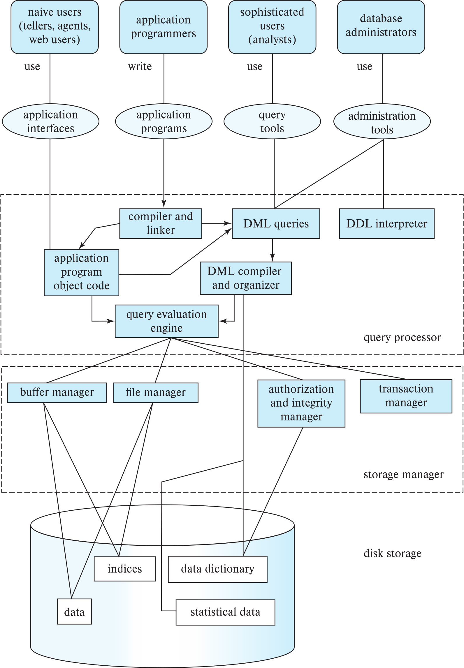
Database Architecture (Centralized/Shared-Memory)

Slide 14
Database Applications
Database applications are usually partitioned into two or three parts
Two-tier architecture -- the application resides at the client machine, where it invokes database system functionality at the server machine
Three-tier architecture -- the client machine acts as a front end and does not contain any direct database calls.
The client end communicates with an application server, usually through a forms interface.
The application server in turn communicates with a database system to access data.
Notes:
14

Slide 15
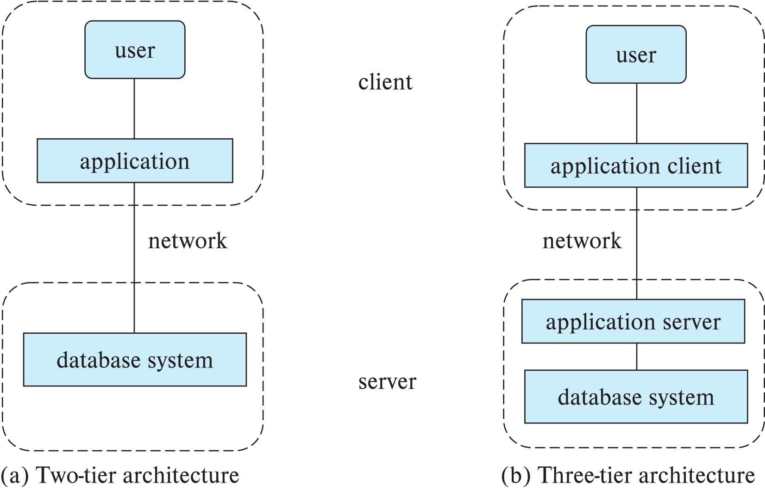
Two-tier and three-tier architectures
Notes:
15

Slide 16
Database Users
Notes:
16

Slide 17
Database Administrator
A person who has central control over the system is called a database administrator (DBA). Functions of a DBA include:
Schema definition
Storage structure and access-method definition
Schema and physical-organization modification
Granting of authorization for data access
Routine maintenance
Periodically backing up the database
Ensuring that enough free disk space is available for normal operations, and upgrading disk space as required
Monitoring jobs running on the database
Notes:
17

Slide 18
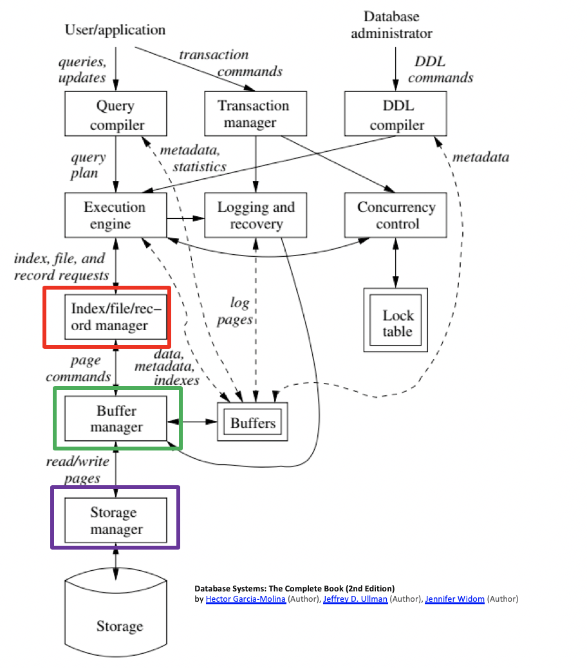
DBMS Implementation Architecture
Find things quickly.
Access things quickly.
Load/save things quickly.

